Slide 1
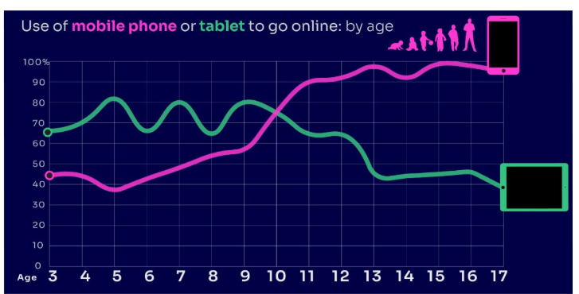


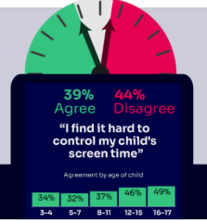


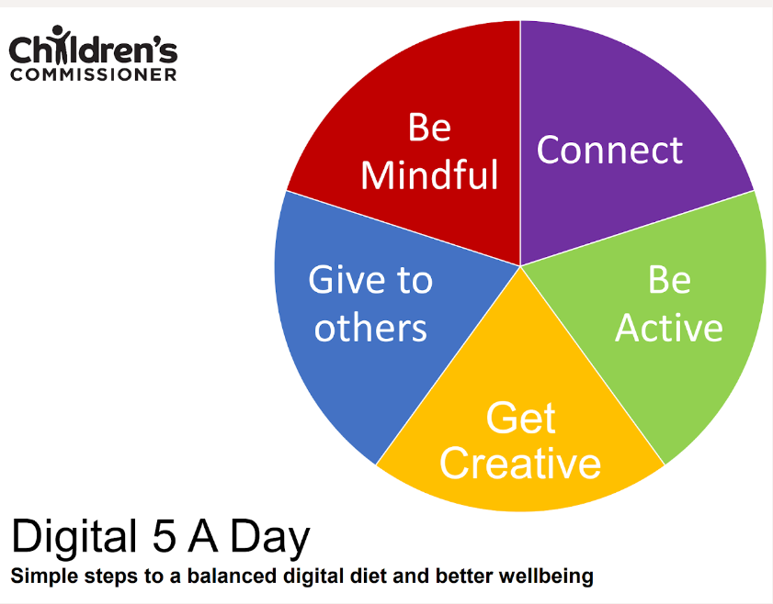

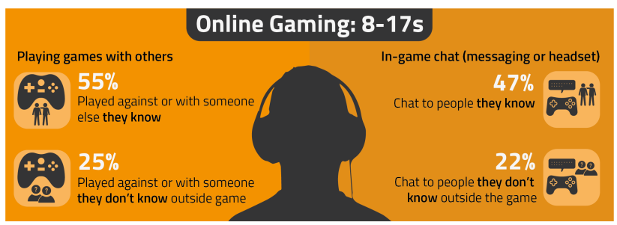

PARENT ONLINE SAFETY
Notes:
This presentation brings together:
- the latest research and key findings on children’s and young people’s online use and risk
- parents’ views about their children’s media use, devices and supervision to monitor or limit use
- suggested resources and tips to empower parents to keep up with the latest trends/apps and games, manage controls and settings, and talk to children about risk - from bullying and sharing content, to extremism and gangs

Slide 2
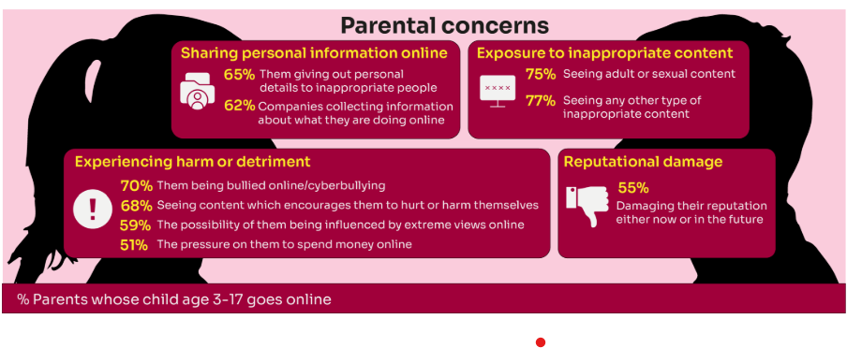
Summary of parental concerns (3 – 17 yr-olds)
Source: Children and parents: media use and attitudes report 2024
Notes:
Many parents indicate that they have concerns around various aspects of their children’s online activities.
The primary concern among parents of 3-17s is that their child will be exposed to inappropriate content for their age group (77% of parents were either very or fairly concerned about this aspect of their child’s online use) or see adult/sexual content (75% of parents).
Another common concern among these parents is that their child will experience some sort of harm or detriment while online; for example, seven in ten parents are concerned that their child will be bullied online (70%) or will see content which encourages them to hurt or harm themselves (68%).
Three in five (59%) parents are concerned that there is a possibility of their child being influenced by extreme views online.
Half (51%) worry about the pressure on their child to spend money online.
More than three in five parents are also concerned about their children giving away their personal data. Sixty-five percent are worried about the personal details the child themself may give out to inappropriate people, as well as 62% of parents who worry about companies collecting information about what their child is doing online.
Finally, over half (55%) of parents said they were concerned about their child’s online use and how it might damage their reputation, either now or in the future.

Slide 3
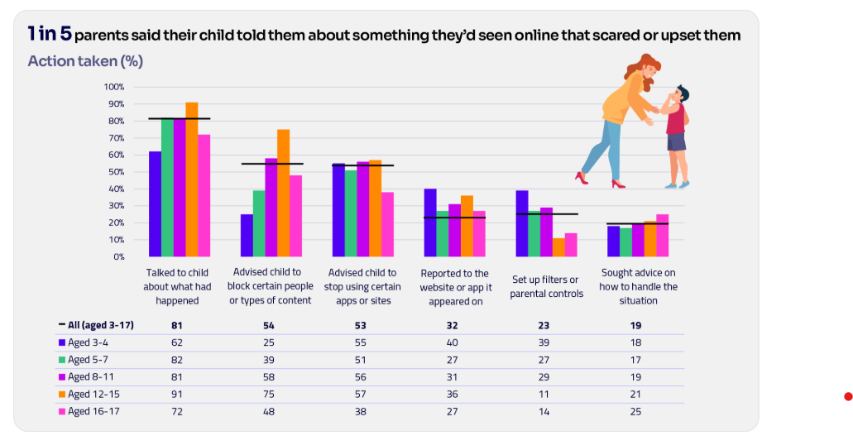
Are you CONFIDENT to TALK TO YOUR CHILD?
Is your child confident to TALK TO YOU?
WHAT WOULD YOU DO?
Are there any areas you would not feel confident or comfortable to discuss?
Younger children are more likely to tell someone if they see something worrying or nasty online:
  Two-thirds of 8-11-year-olds say that they would always tell someone (66%)
  Almost half of 12-15s and 16- 17s (49% and 45% respectively).
Source: Children and parents: media use and attitudes report 2024
Notes:
Four in five parents (81%) chose to talk to their child about what had happened.
Just over half advised their child to block a specific type of content or person (54%) or who recommended that their child stop using certain apps or sites (53%).
However, only a third of parents in this situation (32%) suggested reporting the content to the site or app on which it appeared.
TELL:
You do not need to be an IT expert to help your child stay safe online. One of the best things you can do to protect your children is to talk regularly with them about their use of technology- just as you do with all other areas of parenting.
Having an open and honest approach is best - reacting, without involving them or talking to them, can often push behaviour underground, so it still happens, but you are less likely to know about it. This can increase risk to your child.

Slide 4

YOU don’t need to be an EXPERT … be a PARENT
It’s your choice - Don’t let others dictate when the right time is to use tech.
Stay involved – make time to communicate, talk about what they are doing. What do they enjoy? What makes them laugh?
Don’t quiz them – have regular conversations. What's their favourite app? What is the best site to learn new things from?
Join in - watch them play a game and join in. Who are they playing with? Do they know the other players?
‘Show me how…’ – ask their advice to help you with your privacy settings, who you should add as a friend, are there any risks?
Lead by example - children learn as much from watching as they do from being told not to do something, so model good behaviour
Reassure them - tell them that they won't get in trouble and that you are always there to help.
Notes:
ASK – What do you do that works well? Share good practice
REMIND - You do not need to be a tech expert to help your child with staying safe online. It’s ultimately about communication and being proactive.

Slide 5
By age 11, nine in ten children own their own mobile phone, distinct from using a family device
This correlates with transition from primary to secondary school.
Source: Children and parents: media use and attitudes report 2024
Notes:
As in previous years, the point at which it becomes more likely that a child will go online using a mobile rather than a tablet closely correlates with the age at which mobile phone ownership among children becomes almost universal.

Slide 6

REMEMBER
As children get older, restrictions and controls you use will change, but only at a pace you feel is appropriate for your child, not pressure from your child “because everyone else is allowed”
Content filters are never 100% effective, at some point your child may come across inappropriate or upsetting content, so make time to talk regularly

Slide 7
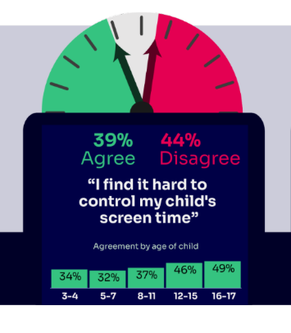
WORRIED about their SCREENTIME??
Do you know HOW LONG YOUR CHILD SPENDS online daily?
Children spent an average 3 hours 5 minutes per day accessing the internet, across smartphones, tablets and computers
Four in ten (39%) parents of children aged 3-17 report finding it hard to control their child’s screentime
Visit screentime.lgfl.net for advice and tips to manage screentime
Source: Children and parents: media use and attitudes report 2024
Notes:
Parents’ concerns about their child’s screentime increases with age - Overall, four in ten (39%) parents of children aged 3-17 report finding it hard to control their child’s screentime. This increases with age, going from a third (34%) for parents of 3-4-year-olds to half (49%) of parents of 16-17-year-olds.
Threequarters (74%) of parents aged 3-4 agreed that their child had a good balance, compared to just over half of parents of older children (56% and 55% for parents of children aged 12-15 and 16-17 respectively).

Slide 8
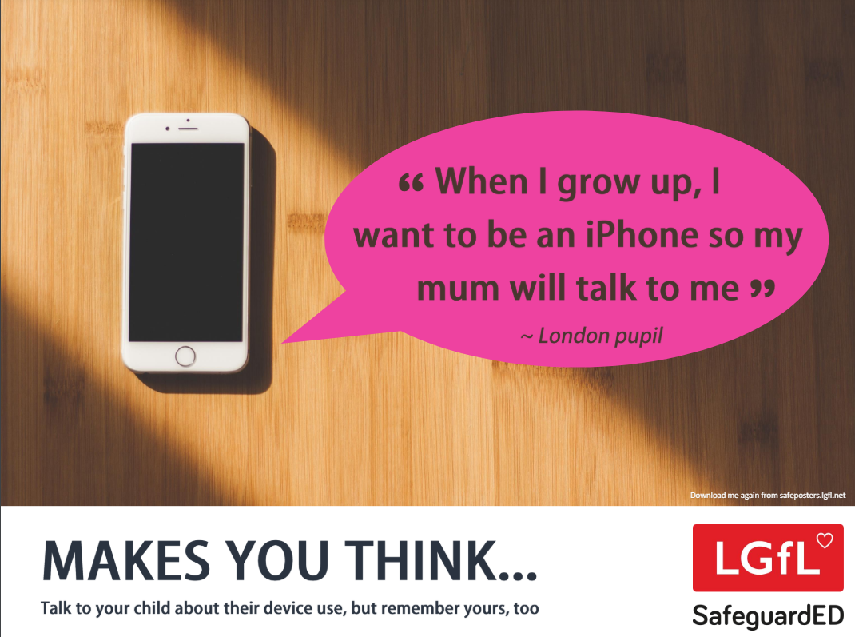
How does your child feel about YOUR SCREENTIME vs THEIRS?
45% of 8-11s feel that their parents’ screentime is too high
35% of 8-17s feel that their own screentime is too high
Source: Children and parents: media use and attitudes report 2024
Notes:
REMIND – it’s important to model good behaviour when it comes to device use, as children will follow our example. The same goes for ‘sharenting’ (see slide 22)

Slide 9

Notes:
PLAY VIDEO – ‘Life Online - What Grownups Just Don't Get!’
This video is part of our playlist on what children and young people actually think about some of the top topics and hot potatoes of the day in 2024. You can discuss key points from this to facilitate conversations to break down barriers to keeping children safe online.
https://youtu.be/Lde52EtjljQ?si=QZSHL0Gn31LRCO1T

Slide 10
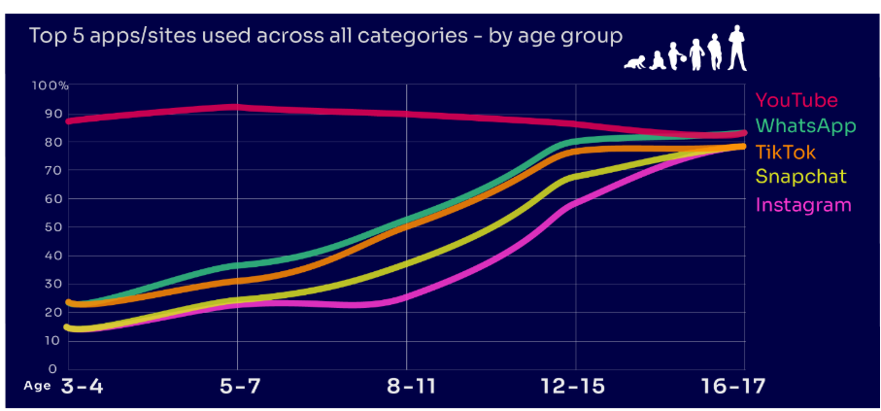
Are you FAMILIAR WITH THE APPS and GAMES your child is on?
YouTube is the most popular, but the appeal of many social media platforms varies by age
under two in ten of all 3-4-year-olds use Instagram and/or Snapchat
this rises to eight in ten among 16-17s
under a quarter of all 3-4-year-olds use WhatsApp
this rises to over eight in ten of all 16-17-year-olds
Go to apps.lgfl.net for guidance on apps and social media sites
Source: Children and parents: media use and attitudes report 2024
Notes:
YouTube is the most-used app or site among the children in our study, with more than eight in ten 3- 17-year-olds using it. However, while YouTube is a popular app across all age bands, some sites or apps grow in popularity with age. For example, just under two in ten of all 3-4-year-olds use Instagram and/or Snapchat (17% in each case) but this rises to eight in ten among 16-17s (for both apps). Similarly, just under a quarter (23%) of all 3-4-year-olds use WhatsApp, and this rises to over eight in ten (83%) of all 16-17-year-olds. This underlines the more interconnected and social nature of older children’s online behaviours; indeed, half (49%) of all 16-17-year-olds use all five of the top apps/sites (YouTube, WhatsApp, TikTok, Snapchat and Instagram).
REMIND – your children need to be 13+ to use these platforms (See slide 39)

Slide 11
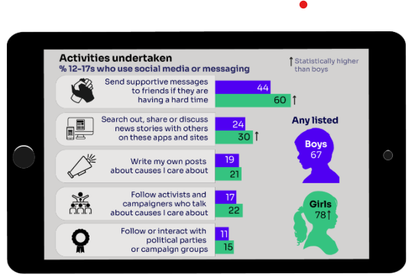
KNOW WHAT THEY DO on social media?
Eight in ten (81%) of all children aged 8-17 use at least one social media app/site for following friends, people and organisations, reading, liking or sharing content
Many used sites and apps like TikTok and Instagram to consume content
Snapchat was the most favoured platform to message and communicate with friends.
“I don’t think I could live without Snapchat anymore…. I’ve got all my friends on it, and we have like group chats where we all call, like, all the time, and we text each other and Snap each other” Suzy, 12
Go to apps.lgfl.net for guidance on apps and social media sites
Source: Children and parents: media use and attitudes report 2024
Notes:
TELL - Motivations for using these types of app vary, but a key reason is the desire to connect with peers. Seven in ten (68%) 8-17-year-olds who use social media and/ or messaging sites or apps told us that using these types of sites or apps helped them feel closer to their friends, either all or most of the time.

Slide 12

What about YOUNG PEOPLE?
Nearly eight in ten children are aware of minimum age requirements
Four in ten admit to giving a fake age online to access a new app/site
Up to a quarter had changed their date of birth on their profile since initially setting it up:
  Facebook (24%)
  TikTok (23%)
  Instagram and X/Twitter (both 19%)
Children’s Online User Ages 2023 Quantitative Research Study
Notes:
Up to a quarter of children aged 8-17 said they had changed their date of birth on their profile since initially setting it up.
• This was most likely to be cited for Facebook (24%) and TikTok (23%), followed by Instagram and X/Twitter (both 19%).
• Proportions doing this were higher among 8-12s for both TikTok and Instagram.
-

Slide 13
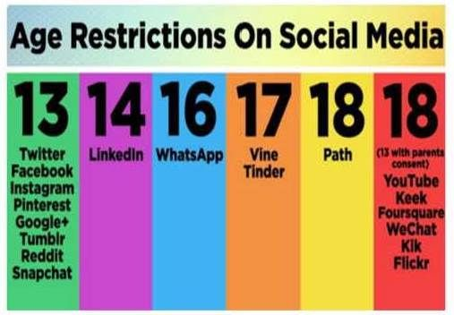

Slide 14
How can YOU GET INVOLVED?
ASK what type of games your child enjoys – are they age-appropriate?
PLAY games together - keep the tech in shared spaces rather than bedrooms
TALK about who they are playing with - what information are they sharing?
EXPLAIN what is/isn’t appropriate to share, e.g. personal details to identify them/location
AGREE how they will spend their money online
DISCUSS what they would do if they were bullied online, and what steps to take
DECIDE how long is appropriate to play in one session - how many sessions a day
SETUP these restrictions in parental settings with your child
Visit gaming.lgfl.net for advice and activities to keep them safe
Source: Children and parents: media use and attitudes report 2024

