Slide 1
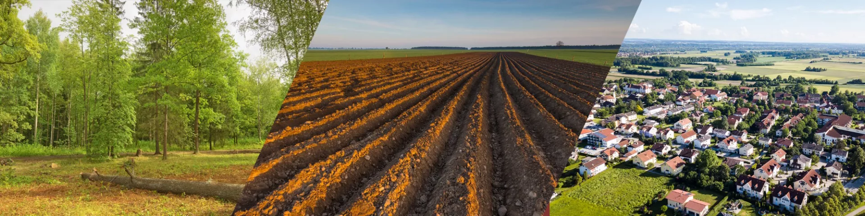
Land Use
Geography: All Around The World
Can I create a sketch map of the local area?
Can I use a key on a map to show how land is used?
How is land used in settlements?
How are settlements linked?
What makes a settlement ideal?
Science: Forces
Recognise magnetic materials
Describe magnets as having 2 poles
Predict whether 2 magnets will attract or repel each other, depending on which poles are facing
PE: Athletics
Running: relay, 100m and 500m
Jumping: Long jump, speed jump and hurdles.
Throwing: javelin/howler.
Computing: Media: Audio Production
Recording sound
Editing audio
Planning and creating a podcast
Sharing and evaluating
Music: Fly with the stars
Play the chords of Fly with the stars on tuned percussion as part of a whole-class performance.
Sing solo or in a pair in call-and-response style.
Respond to and recognise crotchets and quavers and make up rhythms using these durations to create accompaniment ideas for the song.
PSHE: No way through isn’t true!
Exploring resilience and endurance.
Learning about inspirational people.
Developing growth mindset.
Art/DT: Craft and design: Fabric of nature
- Using flora and fauna of tropical rainforests as a starting point, children develop drawings through experimentation and textile based techniques to design a repeating pattern suitable for fabric.
Martins, Term 6
English
Key Text: The Boy Who Biked the World
Diary Writing: Shared writing, based on the text - Tom leaving his family.
Diary Writing: Independent write - a day travelling.
Instructional Writing: How to make a banana sandwich. How to fix a puncture.
Explanation text: How to survive in the desert
GPAS:
- Word families, prefixes and paragraphs.
Mathematics
Shape and geometry
Turns and angles
Quadrilaterals and polygons
Symmetry
Coordinates
Using a grid and translating
Statistics
Pictograms
Bar charts, line graphs and two-way tables
Interpreting and representing data
RE: Humanism
What do people believe and think about God? How does non-religious belief shape and influence everyday life? ​
How does belonging to a faith community guide and influence everyday attitudes (head), responses (heart) and actions (hands)?

